Slide 1
Microsoft Sentinel
SIEM + SOAR

Slide 2
Sentinel is:
Cloud-Native Security Information and Event Management (SIEM) and Security Orchestration, Automation and Response (SOAR) Tool
It is built into Azure as a Cloud Resource
Collects, correlate, detects, investigates and possibly responds to threats
It is designed to enhance visibility, Automation and also to scale

Slide 3
CORE COMPONENTS OF SENTINEL
Data Sources
Detections using Analytics
Incidents and Investigations
Automation & Responses: Using Logic Apps

Slide 4
User Roles in Sentinel
Microsoft Sentinel uses Azure role-based access control (Azure RBAC) to manage permissions. This system uses built-in roles to give different users the exact permissions they need to do their jobs. The four primary roles are:
Microsoft Sentinel Responder
Microsoft Sentinel Contributor
Microsoft Sentinel Playbook Operator
Microsoft Sentinel Automation Contributor
Log Analytics Roles

Slide 5
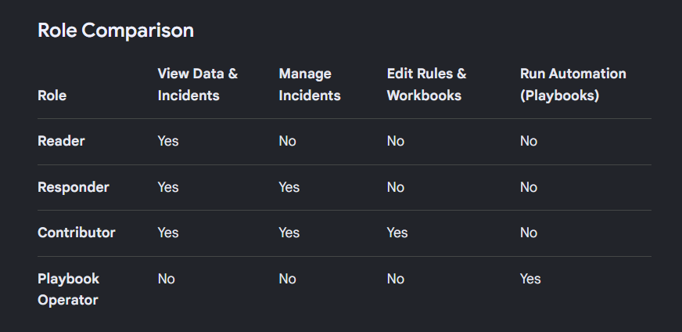

Slide 6
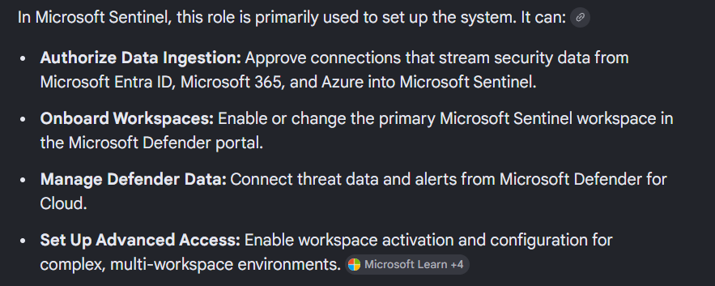
Azure Security Administrator Role
The Security Administrator role is an identity permission. It gives access to Microsoft Entra ID (formerly Azure AD) and Microsoft Defender.

Slide 7
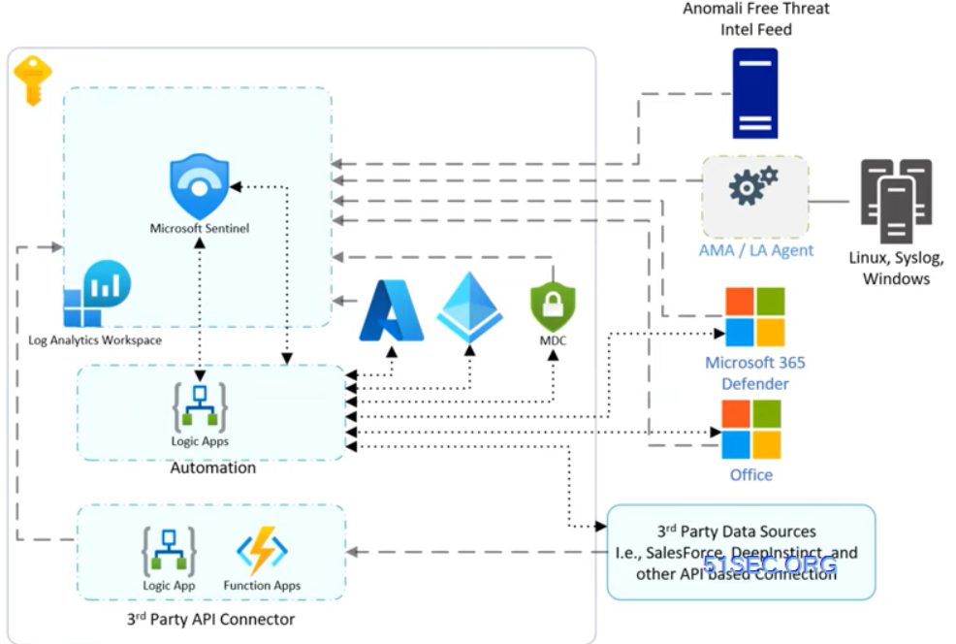
Data Ingestion in MS Sentinel

Slide 8
DEMO

Slide 9
Q&A

